Slide 1
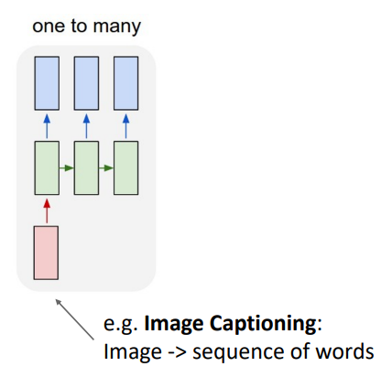
Project topic
Image captioning using CNN, LSTM
Team member
Abhinaya Movva
Harsha Kolla
Project Objective
Train a Deep Learning model to generate a text caption for an input image
Ref paper - https://arxiv.org/abs/1411.4555

Slide 2
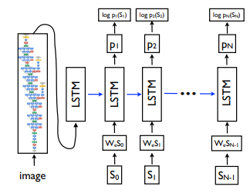
Approach
Get image embedding using a pre-trained CNN model
Train a LSTM based sequence to sequence model to map the image embedding to text
It will be a vector to sequence mapping, we will use categorical cross entropy as Loss
Train the model on Loss
Evaluate the model on BLEU score
Dataset
We will be using the Vusual Q and A dataset for our purpose. It has a pair of Image and question. We will manually convert the questions into answer to serve as the caption. Or we can create fresh question from the image.
URL -
https://visualqa.org/
http://images.cocodataset.org/zips/val2014.zip

Slide 3
Sample data
How we prepare the dataset
We have created simple and easy trainable caption following the format subject → verb → object
We have kept the subject to man, woman, boy, girl
Object is limited to basic day to day activity
Images are personal Photographs
a girl swimming in water
a man holding a dog
a girl drinking coffee
a office building
front door of office
a tree on a road
office garden
a tree in park
a board in park
a board in park
a park pathway
a small shade in the park
a board on the road
a empty staircase
a man holding a kid
traffic board in park

Slide 4
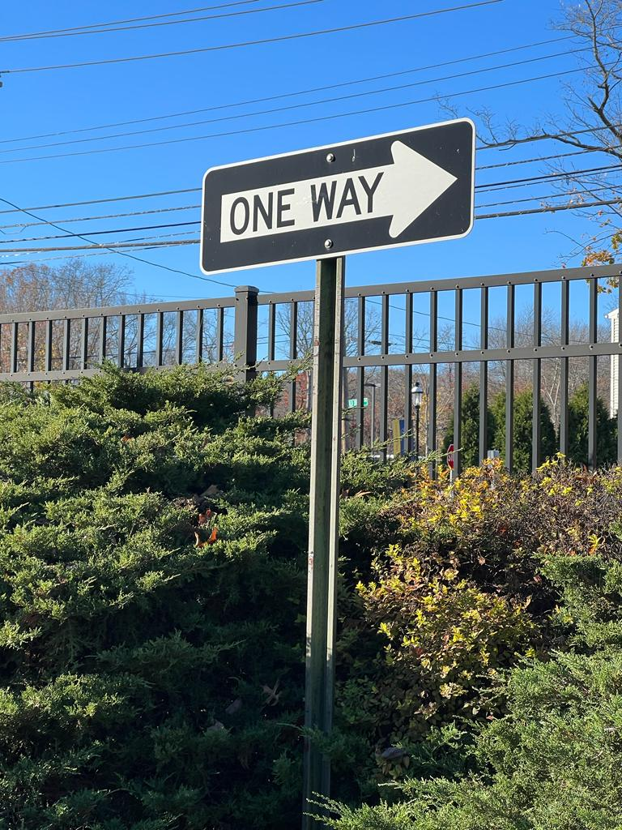
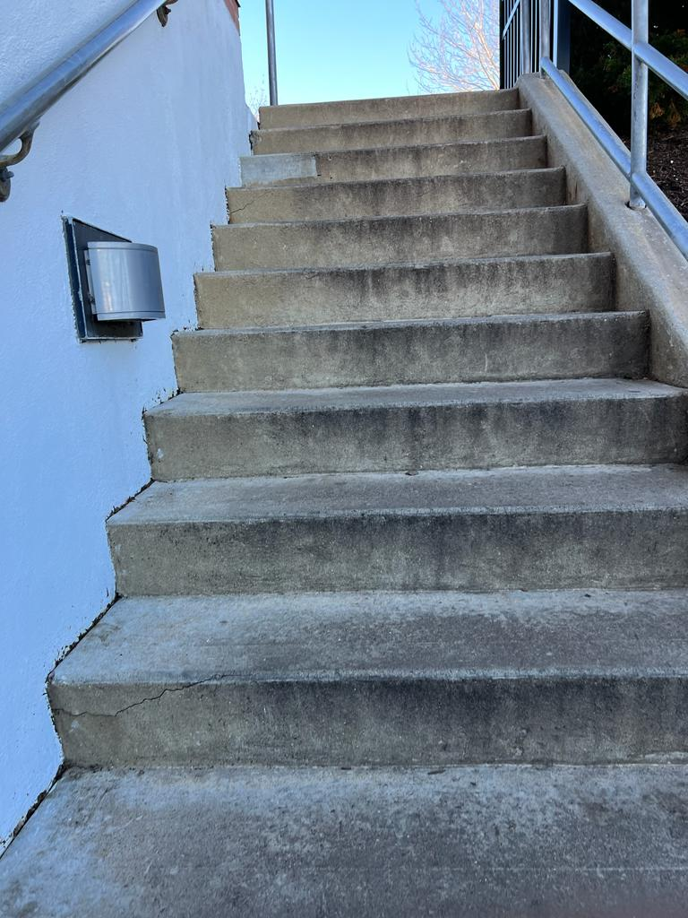
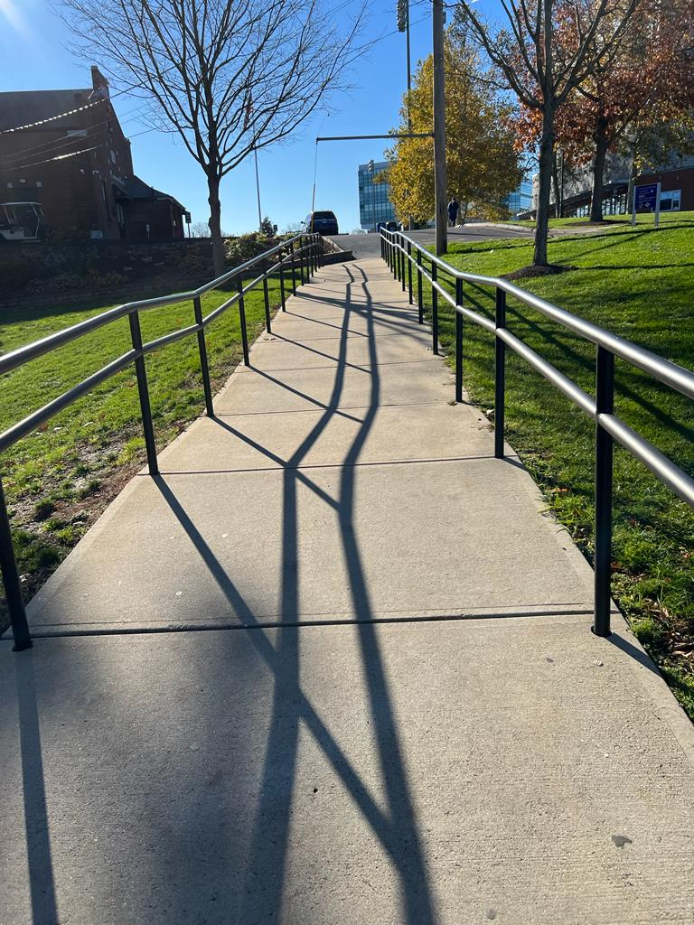
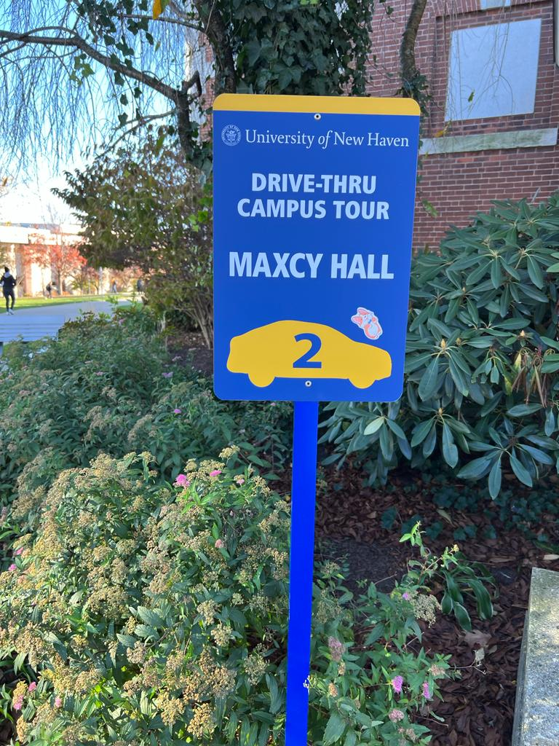
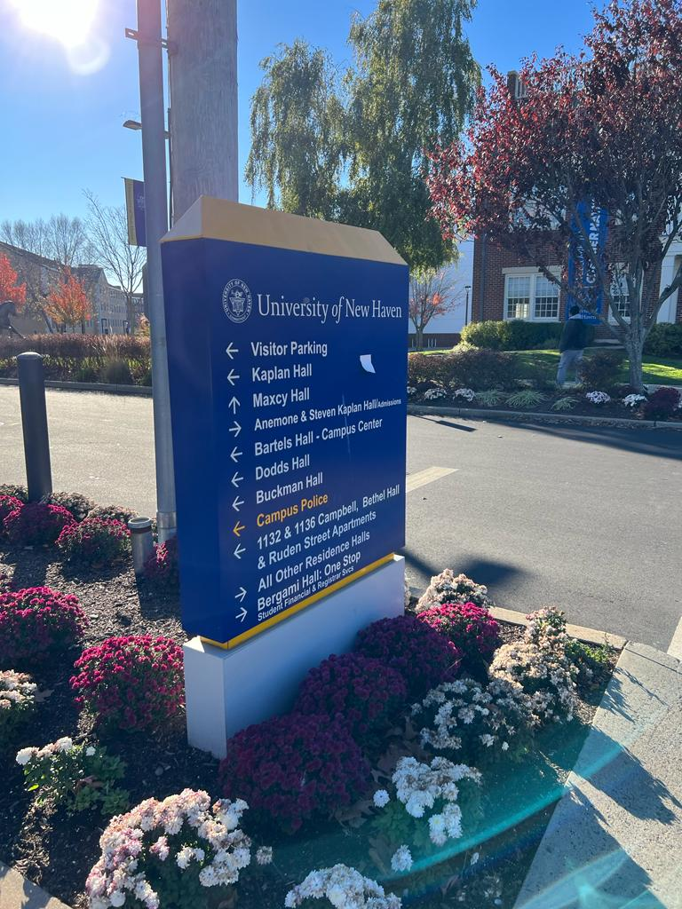
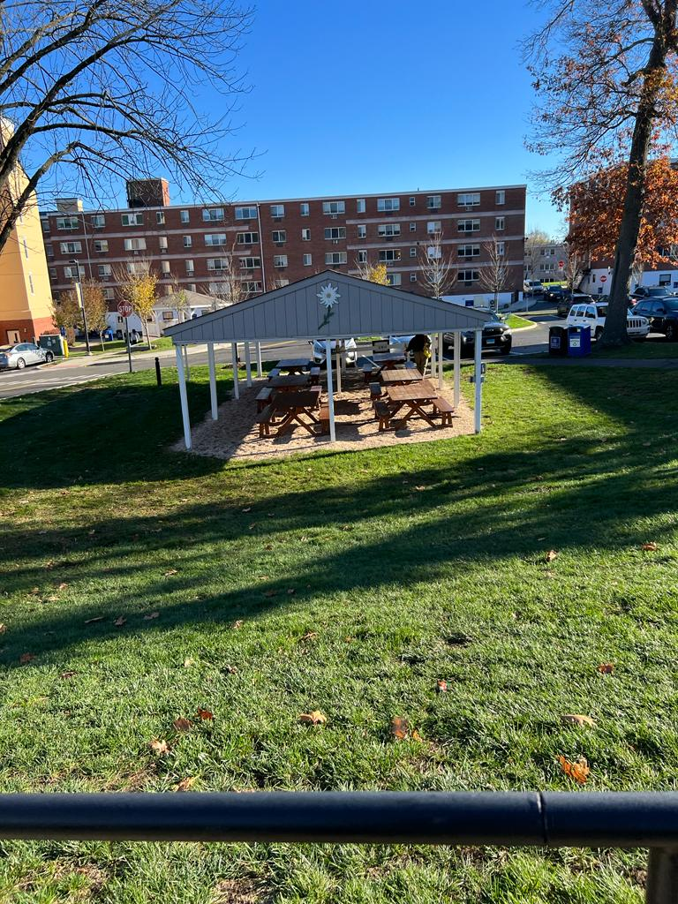
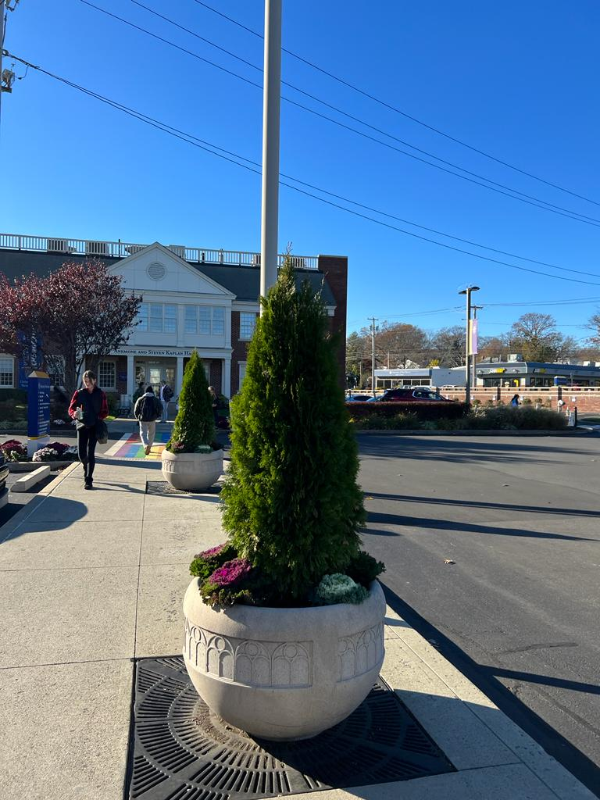
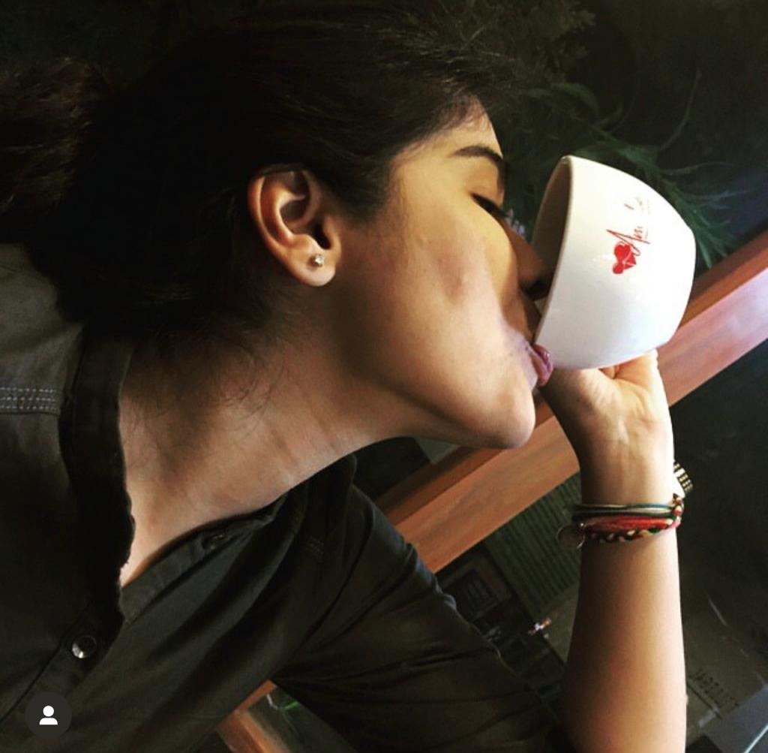
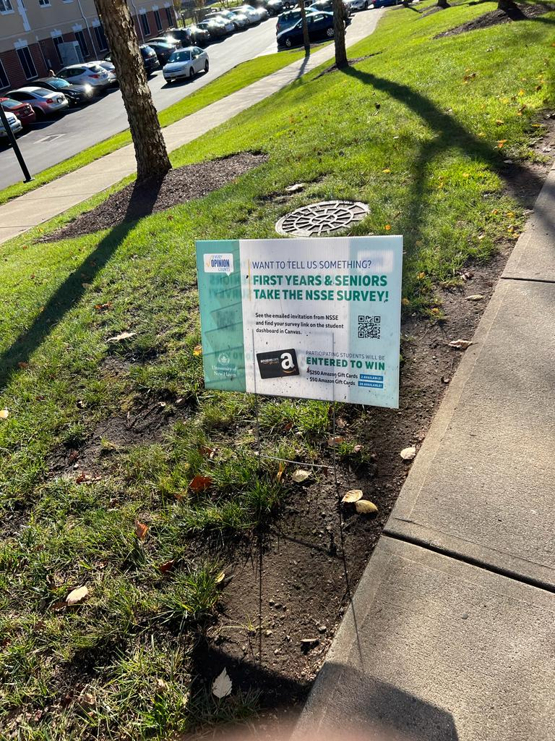
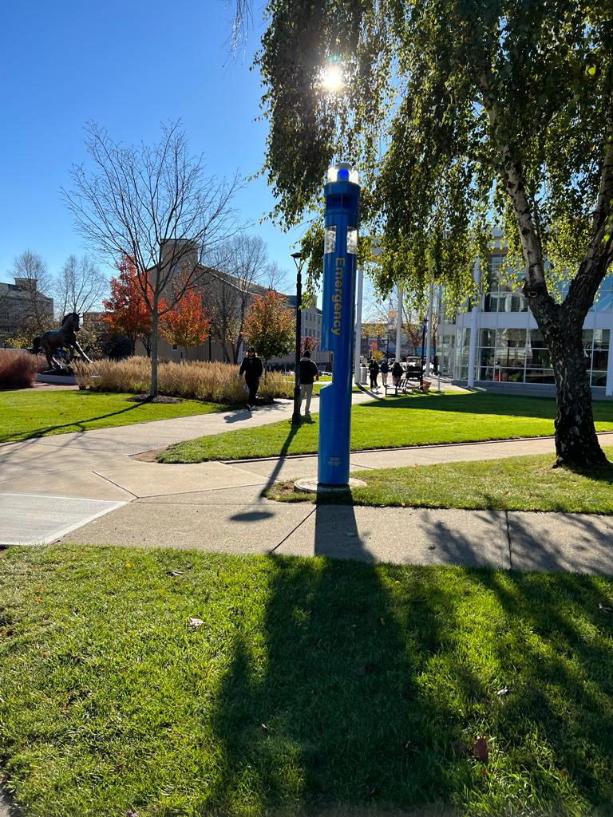
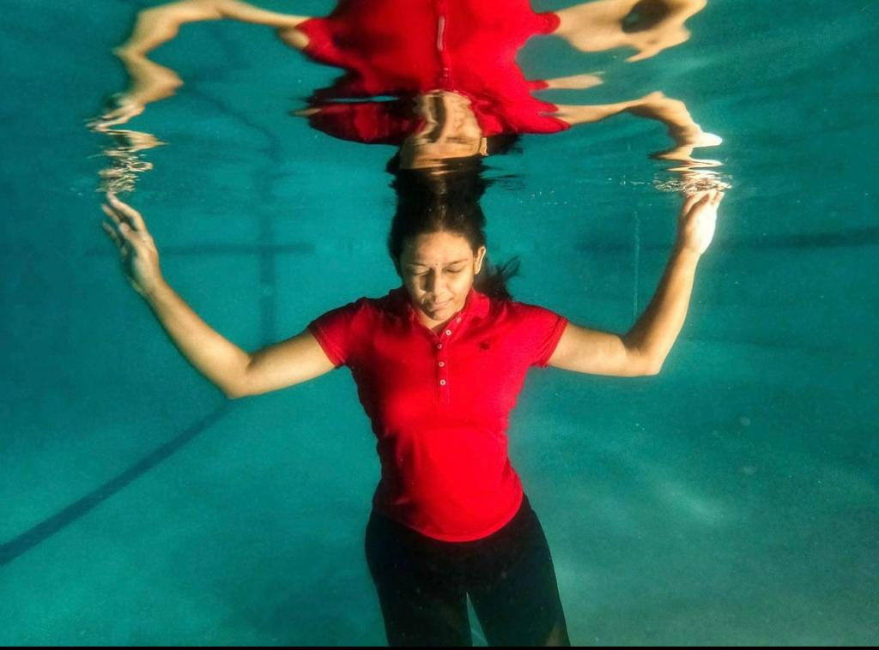

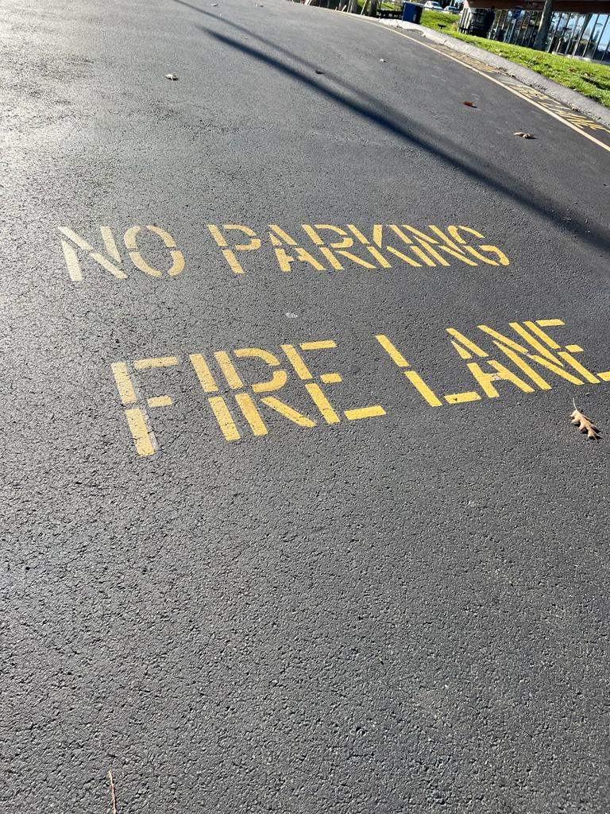
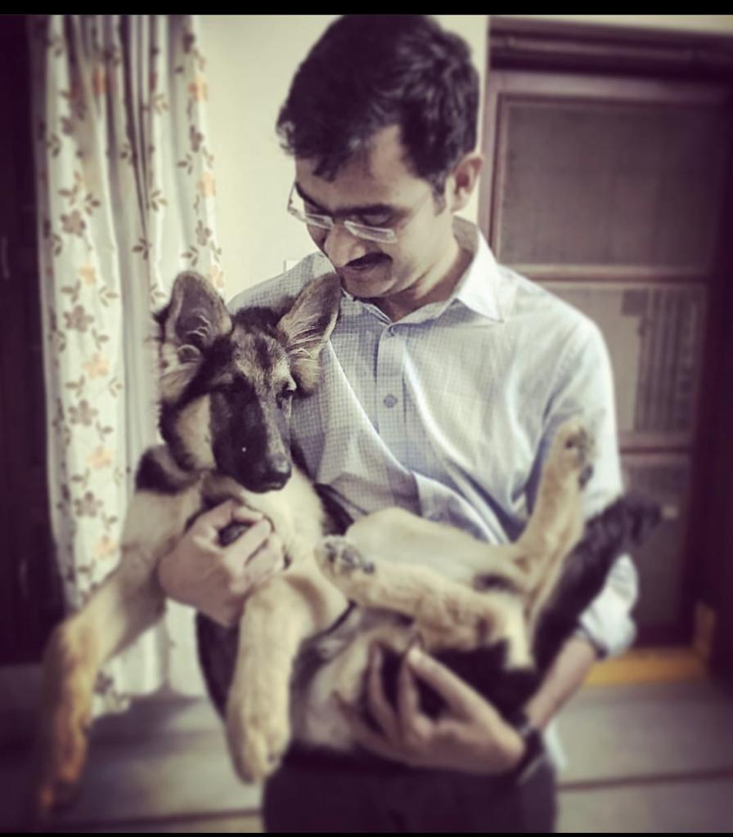
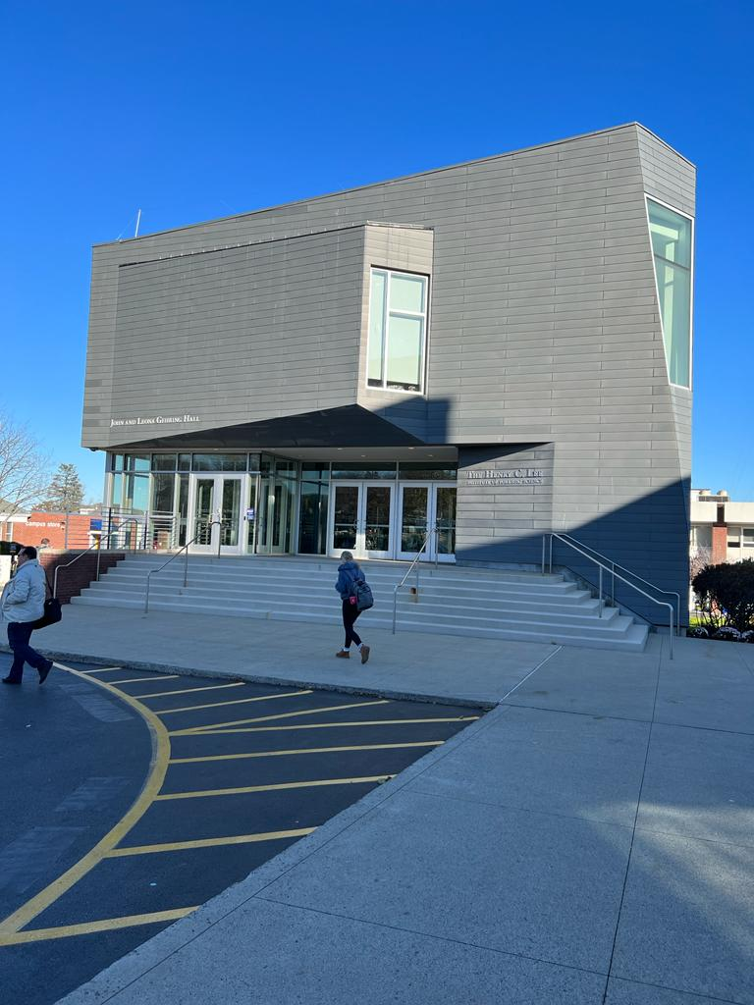
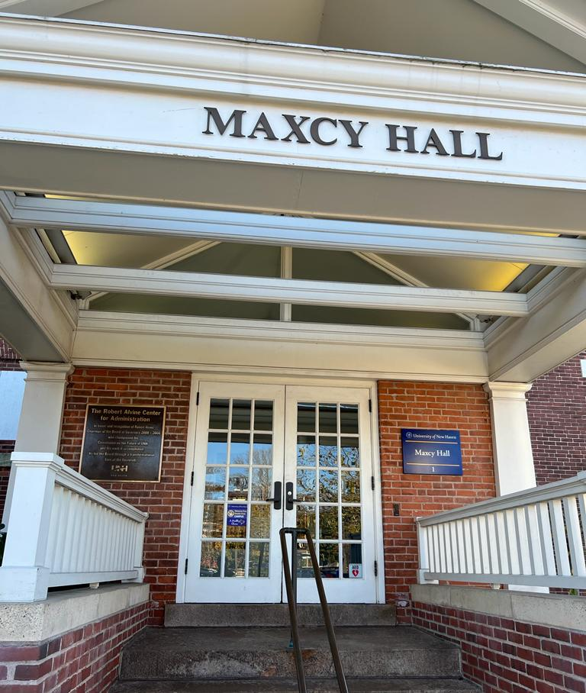
Sample data

Slide 5
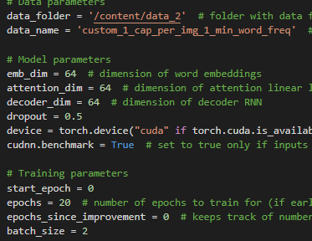
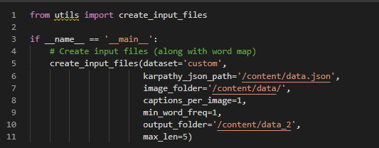
Code
The reference code is used to train and preprocess the dataset
Changes made-
Created custom json file for the loader to map our own dataset
Changes Embedding dimensions, attention size, RNN size, Batch size
Change in file create utils to map to our json and images
References
Show and Tell: A Neural Image Caption Generator - https://arxiv.org/abs/1411.4555
Github code - https://github.com/sgrvinod/a-PyTorch-Tutorial-to-Image-Captioning

Slide 6
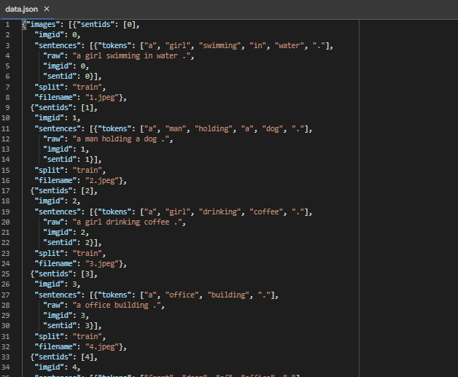
Code
The reference code is used to train and preprocess the dataset
Changes made – created data.json for our images in the required format
Show and Tell: A Neural Image Caption Generator - https://arxiv.org/abs/1411.4555
Github code - https://github.com/sgrvinod/a-PyTorch-Tutorial-to-Image-Captioning

Slide 7
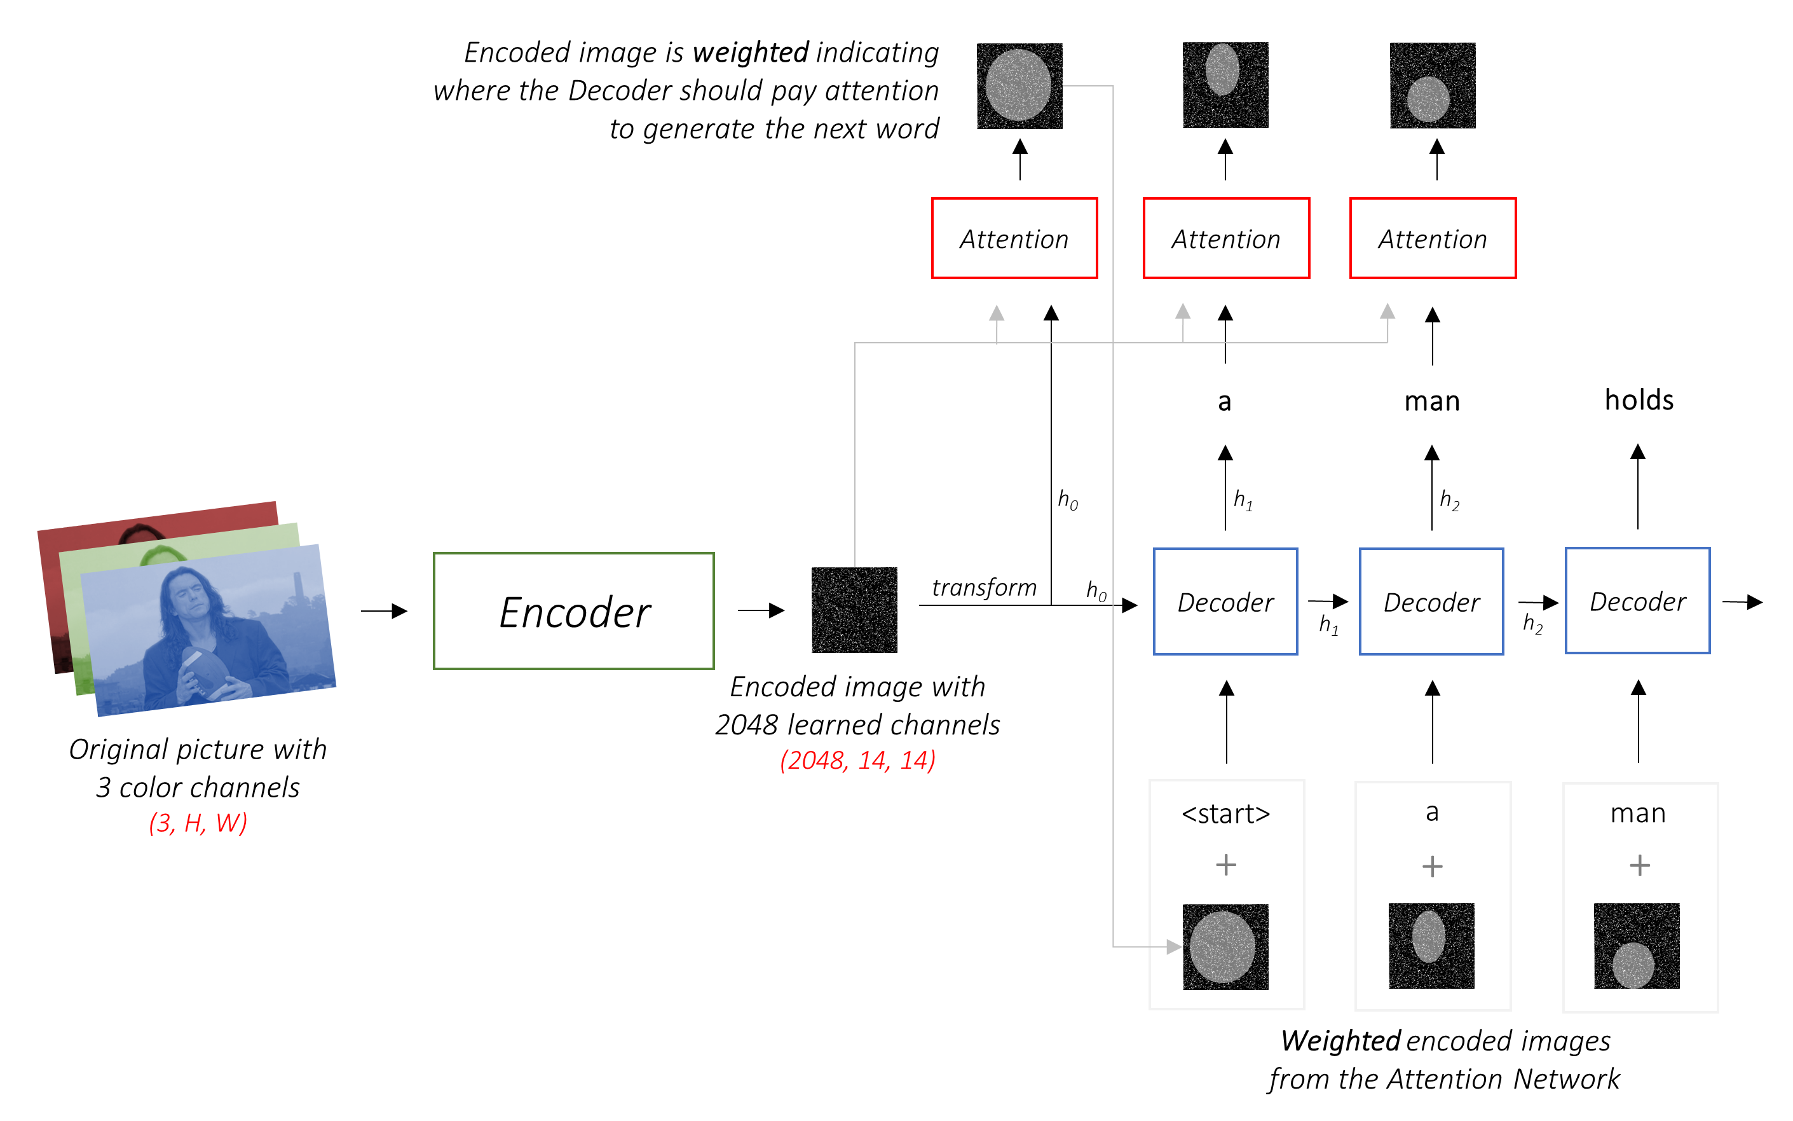
Architecture

Slide 8
Training score
Epoch: [1] Top-5 Accuracy 80.000 (80.000)
Epoch: [2] Top-5 Accuracy 60.000 (60.000)
Epoch: [3] Top-5 Accuracy 80.000 (80.000)
Epoch: [4] Top-5 Accuracy 80.000 (80.000)
Epoch: [5] Top-5 Accuracy 80.000 (80.000)
Epoch: [6] Top-5 Accuracy 60.000 (60.000)
Epoch: [7] Top-5 Accuracy 60.000 (60.000)
Epoch: [8] Top-5 Accuracy 60.000 (60.000)
Epoch: [9] Top-5 Accuracy 60.000 (60.000)
Epoch: [10] Top-5 Accuracy 60.000 (60.000)
Epoch: [11] Top-5 Accuracy 60.000 (60.000)
Epoch: [12] Top-5 Accuracy 80.000 (80.000)
Epoch: [13] Top-5 Accuracy 80.000 (80.000)
Epoch: [14] Top-5 Accuracy 80.000 (80.000)
Epoch: [15] Top-5 Accuracy 60.000 (60.000)
Epoch: [16] Top-5 Accuracy 60.000 (60.000)
Epoch: [17] Top-5 Accuracy 60.000 (60.000)
Epoch: [18] Top-5 Accuracy 60.000 (60.000)
Epoch: [19] Top-5 Accuracy 100.000 (100.000)

